Slide 1


Local Regulation of Small Cells and Other Wireless Facilities
SCAN NATOA Chapter Meeting
Northern California
February 6, 2020
Notes:
Good Evening Mayor and Members of the City Council.
My name is Nicole Jules and I’m with Interwest Consulting Group.
We’ve been retained to assist the City with updating its current policies, procedures and governing rules to address the rapidly evolving Wireless telecommunications environment.
I have over 25 years Professional Civil Engineering Experience of which 17 of those were with the City of Rancho Palos Verdes where I spent a huge amount of my time managing the deployment of wireless telecommunications throughout the City.
I worked closely with Electeds, Residents, Attorneys, Experts and Carriers, to develop an ordinance that complied with State and Federal laws, Local preference and Carrier deployment objectives
As outlined in the Agenda Bill, staff is seeking Council’s feedback regarding the approach as outlined this presentation.
LETS GET STARTED

Slide 2

Nicole Jules, P.E.
Interwest Consulting Group
Director of Traffic Engineering Services
Jack of all trades, master of none

Slide 3

Municipal Perspective
5G is here and coming to a town near you!
In its early stages of deployment
Backbone infrastructure (conduit, fiber optics) are being rolled-out first
Targeting SCE or municipally owned poles
FCC Order 18-133 accelerates wireless deployment by removing bureaucratic barriers

Slide 4
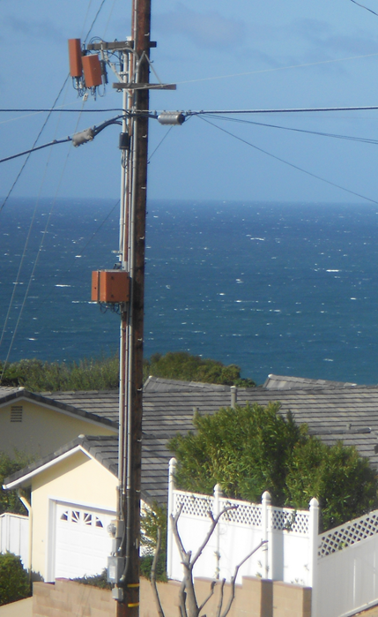
Municipal Perspective
Municipal Code through Ordinances and Resolutions allow Cities to:
  Establishes guidelines for permitting, placement, design & maintenance of wireless telecommunications facilities in all areas of the City
  Prescribe equitable criteria for consistent processing
With the Intent to:
    Protect the health, safety & welfare of residents & visitors
    Preserve aesthetic values
    Minimize vertical obstructions in the PROW

Slide 5
Municipal Perspective – Do’s and Don'ts
  Cities cannot prohibit provision of wireless facilities
    Cities can govern time, place & manner
  Cities cannot take extended time to issue permits
  Cities can control aesthetics
  Cities cannot charge random fees without justification
Notes:
There are a handful of Federal & State laws that govern the telecommunications industry, specifically the role that local agencies play when processing permits.
While I’m certain your City Attorney has briefed you on these, I’ll go over their significance:
Federal Telecommunications Act of 1996 –
California Public Utilities Code –
Federal Communications Commission (FCC) -

Slide 6
Municipal Perspective – Permitting
Administrative (Director) or Discretionary (Planning Commission or Council)
10-day initial review period
Notice of Incomplete or Complete Application
60 or 90 days shot-clock to review plans
  (60 for minor mod, colocation or replaced infrastructure)
  (90 days for facilities on new infrastructure)
Possible public hearing, mock-up & notification
After application approval then Encroachment Permit & Construction

Slide 7
Municipal Perspective – Small Cell Deployment

Slide 8
Small Cell Deployment – Antenna Only
Street light
Two panel antennas
Ground-mounted radios and other equipment
In-ground pull box for cables and conduit

Slide 9
Small Cell Deployment – Fully integrated pole
Top-mounted antenna
Street light
Slim line tapered pole
Unrelated balloons
Traffic signs
Equipment fully integrated inside pole
Undergrounded equipment

Slide 10
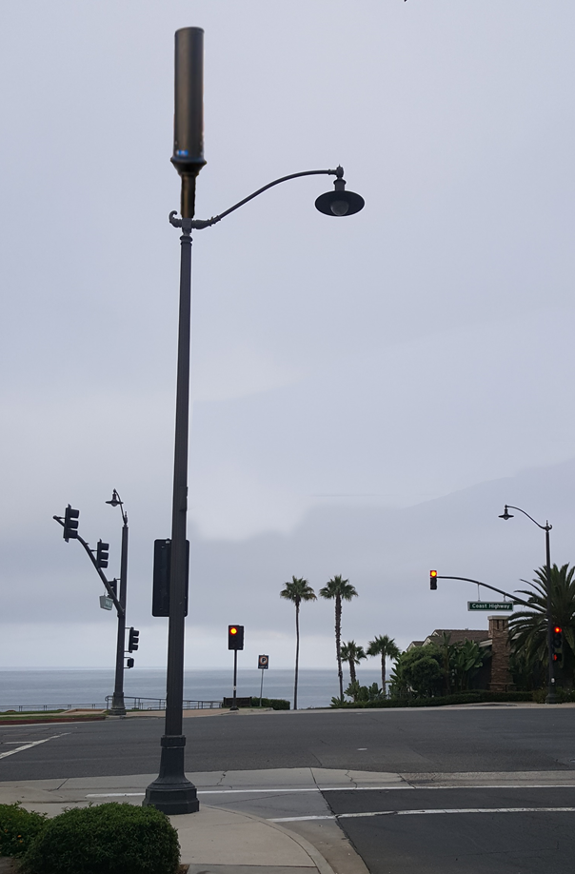
Small Cell Deployment – Ornamental Street light
Antenna
Street light
Customized style and color
No ground-mounted equipment
Equipment fully integrated inside pole
Coast Highway at Wesley Drive

Slide 11
Small Cell Deployment – Collocated Site (Same Carrier)

Slide 12
Residential Neighborhood Deployment
    No ground-mounted equipment
    No view corridor impacts
    Minimal spacing requirements
    Designs would be consistent with Street Lighting Guidelines

Slide 13
Municipal Perspective – Concerns
  Municipal priority is public health, safety & welfare
  Demanding wireless telecoms wanting special considerations
  FCC Order has created undo burden on staffing & other ROW users
  Applicants “squat” on locations. Shot-clock is one-way
  Backbone roll-out implies guaranteed node siting.
Notes:
There are a handful of Federal & State laws that govern the telecommunications industry, specifically the role that local agencies play when processing permits.
While I’m certain your City Attorney has briefed you on these, I’ll go over their significance:
Federal Telecommunications Act of 1996 –
California Public Utilities Code –
Federal Communications Commission (FCC) -

Slide 14
THANK YOU!

