Slide 1
SCAN NATOA CHAPTER MEETING
LOCAL REGULATION OF “SMALL” Cells
And other wireless facilities
Long Beach Billie Jean King Library-Main Branch
200 W Broadway Long Beach CA. 90802
THURSDAY FEBRUARY 13, 2020
10AM - Noon
Michael Watza
Kitch Drutchas Wagner Valitutti & Sherbrook 1 Woodward Ste 2400 Detroit, MI 48226
General Counsel PROTEC
E Mail: Mike.Watza@Kitch.Com
O: (313) 965-7983 M: (248) 921-3888
www.protec-mi.org/
www.kitch.com

Slide 2
“Keep it simple shall we?”

Slide 3
THE ART OF ADVOCACY 1ST – LETS DISPENSE WITH THE CAREFULLY DESIGNED INDUSTRY NOMENCLATURE

Slide 4
“SMALL” IS NOT “SMALL”
US 1st Circuit Court of Appeals rejects “small” cell and “pizza box” designation by the FCC and industry
- UNITED KEETOOWAH BAND OF CHEROKEE INDIANS v FCC No. 18-1129 (August 9, 2019)
“…the Commission inadequately justified its portrayal of deregulation’s harms as negligible. The FCC partly based its public-interest conclusion on a picture of small cells that the record does not support. It described small cells as “materially different from the deployment of macrocells…the Commission sums up its explanation of the difference: “small cells are primarily pizza-box sized, lower-powered antennas that can be placed on existing structures.”…but the Commission fails to address that small cells are typically mounted on structures 50 feet or less in height including their antennas”….”
-Not to mention +28 cubic feet of equipment plus unlimited number of antennas per final rules at appendix A to declaratory ruling and third report and order of 9/27/2018
-Note other FCC reversals in US Cts of Appeal

Slide 5
“RIGHT OF WAY CELL TOWERS”
Lets call a pig, a pig.

Slide 6
2^{nd -} WHY ARE WE HERE? IT’S ALL ABOUT THE MONEY “Sprint…to cut…network costs by relocating to…government-owned properties, which cost much less.” http://www.recode.net/2016/1/15/11588832/sprint-finalizes-plan-to-trim-network-costs-by-up-to-1-billion

Slide 7
$$ VERSUS LOCAL CONTROL
§ 29 Highways, streets, alleys, public places; control, use by public utilities.
No [one] …shall have the right to the use of the highways, streets, alleys or other public places …without the consent of the duly constituted authority of the county, township, city or village;
or to transact local business therein without first obtaining a franchise from the township, city or village.
…the right of all counties, townships, cities and villages to the reasonable control of their highways, streets, alleys and public places is hereby reserved to such local units of government.
See also Sections 22 & 34 (Broad Local Powers), Sec 26 (No Loaning Credit), Sec 31 (Legislature cannot vacate or alter ROW

Slide 8
AND 3RD… A PICTURE IS WORTH A THOUSAND WORDS

Slide 9
US 9TH CIR CT SEE NICE CITY LIGHT POST?

Slide 10
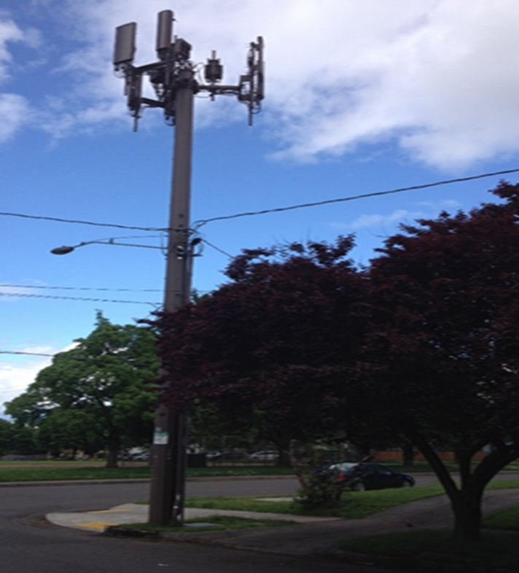
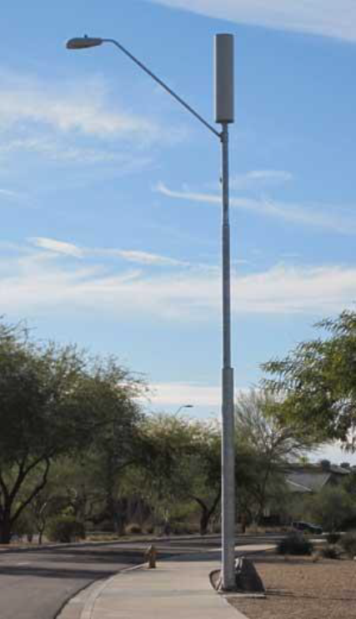
IMAGINE CITY LIGHT POLE NOW

Slide 11
WHY THE FUSS OVER “ SMALL” CELLS IN THE ROW?

Slide 12
“SMALL” CELL DIMENSIONS: 28 CU FT … X 4

Slide 14
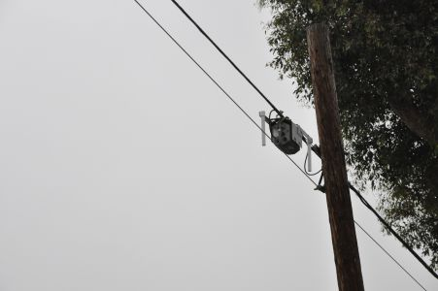
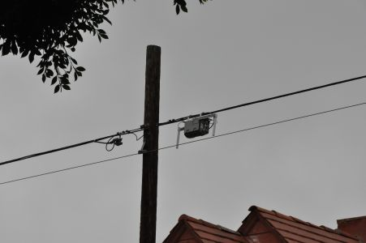
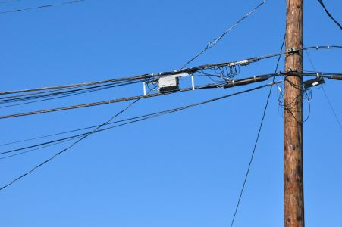
CABLE INDUSTRY WIFI/WIRELESS (Per FCC Sec 621 Order)

Slide 15
LINKS
Two FCC Telecom ROW Access orders. Moratoria Order: https://docs.fcc.gov/public/attachments/FCC-18-111A1.pdf and Small Cell ROW Order https://docs.fcc.gov/public/attachments/FCC-18-133A1.pdf
The FCC Cable In Kind Franchise Order: https://docs.fcc.gov/public/attachments/FCC-19-80A1.pdf and,
Sample State Law: Michigan SB 637 and 894; 2018 PA 365 and 366; MCL 460.1301et seq and MCL 125.3205(1)(c) and 125.3514(10)
http://www.legislature.mi.gov/documents/2017-2018/publicact/pdf/2018-PA-0365.pdf
and,
http://www.legislature.mi.gov/documents/2017-2018/publicact/pdf/2018-PA-0366.pdf
See also August 8, 2019: US DC Circuit Ct of Appeals Order reversing in part an FCC order avoiding environmental review on cellular sites proposed for federal or tribal lands. https://www.cadc.uscourts.gov/internet/opinions.nsf/4001BED4E8A6A29685258451005085C7/$file/18-1129-1801375.pdf

Slide 16
THE OTHER SHOE THE FCC CABLE ORDER
Cable In Kind Franchise Order: This Order involves the FCC proceeding initiated in September 2018, resulting in an August 2, 2019 Order in which the FCC attempts to respond to the cable industry request that it level the ROW access playing field as between the traditional telecoms and the cable industry. The cable industry argument is that it currently pays $3 Billion dollars annually for ROW access. As both industries now largely provide similar communication services, cable argues it is entitled to the same vastly reduced access fees which the FCC Row orders addressed above, have provided cable’s competitors.
Effective Date is September 26, 2019
Appeal pending in US 6th Cir Ct of Appeals
Hearing on our motion to Stay March 10, 2020

Slide 17
The FCC Cable Order
IMPACT
The order principally Reduces Franchise Fees by the market value of all “In kind” and “Grant” requirements included in Cable Franchises Including:
I-Nets, PEG Channel Value (deferred up to one year), PEG Grants, Free Drops, Discounted Service
Mixed-Use Rule: Cable can provide any communication service on the back of its cable franchise w/o further fees or regulation
Effective Date: September 26, 2019
Prospective Application Only
Dispute Resolution: FCC Preemption
https://docs.fcc.gov/public/attachments/FCC-19-80A1.pdf

Slide 18
CONGRESS
Significant Pro-Local Community Franchising Progress Building in House since January 1, 2019, but…Likely a Wait until January 1, 2021…maybe

Slide 19
AND THIS ENDS WHERE?
The FCC has already indicated an interest in preempting all public non-ROW property interests:
Example: Some communities collect $100,000+ in rent currently on each non-ROW City owned cell tower site such as city hall, golf courses and water towers. If the current trend continues these rents will be reduced to near -0- probably by the end of 2019 or early 2020.
And Taxpayers make up the difference

Slide 20
COMMUNITY COSTS: AN ACTUAL EXAMPLE
2016-2019 Legal Fees $100,000+ ($25,000+ Annualized)
Wireless ROW Dispute
Draft Wireless Policy
SB 637 Opposition
_______ County ROW Dispute
FCC Moratoria Order Opposition
FCC ROW Order Opposition
FCC Cable Franchise Fee Opposition
Twp Hall Cell Tower Lease Renewal Negotiations
Twp Hall Cell Tower Easements Negotiations (DAS and other connections)
I-NET/Wired Policy Development ($360,000 annually at risk)
Approx Value of All Wireless ROW Annually at FMV: $1,000,000)
Stripped by Small Cell Laws 2018
Approx Value of All Wireline ROW Annually at FMV: $500,000)
Reduced by 80% by Metro Act 2002
Approx Value Cable Franchise and PEG Fees Annually: $1,500,000)
Stripped by FCC 2019 (tbd)
Approx Value I-NET/Wired Policy Development Annually: $360,000)
Stripped by Mich Video Service Act 2007
Approx Value Twp Hall Cell Tower Tenant Leases (3) Annually: $100,000)
Approx Value of Easements to Cell Tower Annually: $10,000)
TBD 2019
TOTAL COMMUNICATIONS INDUSTRY ANNUAL COSTS TO ONE COMMUNITY: $3,495,000

Slide 21
SOLUTIONS
Enforce Constitutional Home Rule Control of Your ROW

Slide 22
OPEN Q &A

Slide 23
Michael J. Watza Biography
Martindale Hubbell AV Rating
Super Lawyer Designation
Detroit Business Top Lawyer
Michael J. Watza is Co-Chair of the Governmental and Commercial Litigation Practice Groups at Kitch, a full service Law firm based in Detroit, with offices in Lansing, Marquette, Mt. Clemens, Chicago, Ill., Toledo, OH. and Hawaii
Mr. Watza's practice provides litigated, legislative and regulatory solutions on behalf of municipal, health care and private sector clients concerning legislation, Complex Litigation, Governance Issues, Telecommunications including Cable and Cell Towers, Energy, Gaming and Insurance.
Michael has managed multiple legislative initiatives, represented clients in State and Federal trial and appellate courts as well as attended to regulatory matters before State agencies and the Federal Communications Commission and Department of Transportation (PHSMA).
Michael has represented clients in the halls of the Michigan Legislature and Congress through negotiation, drafting and testimony regarding legislation on various issues including energy, transmission line siting, telecommunications (cable and cell towers), pipeline regulation, the formation of inter-governmental authorities and tort reform.
Michael also serves as General Counsel to PROTEC - a consortium of over 100 communities, Chair of the Novi EDC, Chair of Attorney Grievance Commission Grievance Panel #9, Past Chair of the Administrative and Regulatory Law Section of the State Bar and the Government Law Section of the State Bar, Chair of the International Municipal Lawyers Telecommunications Committee and past board member of the Michigan Gaming Control Board and Covenant House Central School Board in Detroit.
Michael has served as an adjunct faculty member at Michigan State University College of Law having taught Communications Law and Policy and Ethics and the Practice of Law and is presently on the faculty of the Michigan State University Institute for Public Utilities.
In 2008, Michael successfully led a coalition of Michigan Cities to Federal Court and Congress to oppose Comcast’s effort to move PEG channels to the 900 channel range resulting in, among other things, an apology by Comcast to Congress.
Michael provided the legal components to the development of the 1st new Municipal Broadband projects in Sebewaing, Marshall and several other communities across Michigan, as well as leading the defense of Rights of Way in the current DAS Siting Issues and Legislation threatening Michigan Communities.
Michael J. Watza
Kitch Drutchas Wagner Valitutti & Sherbrook 1 Woodward 24th Floor Detroit, MI 48226 Mike.Watza@Kitch.Com
O: (313) 965-7983 M: (248) 921-3888

